Slide 1
Introduction to Machine Learning
Dr. Chowdhury Mofizur Rahman
Professor
CSE Department
BRAC University

Slide 2
What is Machine Learning?
It is a sub field of AI
Machine can learn from data/observations and can enhance its performance over time
Machine has become autonomous due to its ability to learn
Before invention of ML, expert systems were written as a collection of rule bases by consulting experts
ML has overcome the need of experts
Main task of ML is classification/regression and prediction

Slide 3
What is Machine Learning?
Easy job for humans is difficult for computers and vice versa
Sorting million of numbers is difficult for humans but easy for computers
Recognizing an animal in a picture is easy for human but difficult for computers
Machine now is at par with human at tasks which were difficult before the invention of ML
ML has applications in almost every areas which we can think of like education/agriculture/transportation/medical/genetics/business etc.
ML applications will dominate the future world
Unregulated and unethical use of ML may cause sufferings for the human race

Slide 4
Some Applications of ML
Disease diagnosis
Fraud detection
Email filtering
Computer vision
Drug design
Bio-Informatics
Smart agriculture
Natural Language Processing (NLP)
Computer Aided Education
Autonomous vehicle and many more …………………………………..

Slide 5

Small Examples
If X1*0.5 + X2*0.5 – 0.25 >= 0 then Y is 1
X1
Other wise Y = 0
0.5
X1 = 0, X2=0 then Y =0
X1=0, X2=1 then Y = 1
X1 = 1, x2 = 0 then Y = 1
X1 = 1, X2 = 1 then Y = 1
Y
-0.25
0.5
X2
X1
0.5
Y
X1 = 0, X2=0 then Y =0
X1=0, X2=1 then Y = 0
X1 = 1, x2 = 0 then Y = 0
X1 = 1, X2 = 1 then Y = 1
-0.75
0.5
X2

Slide 6
Small Examples
Decision Tree
Outlook | Temperature | Humidity | Wind | PlayTennis
Sunny Sunny Overcast Rain Rain Rain Overcast Sunny Sunny Rain Sunny Overcast Overcast Rain | Hot Hot Hot Mild Cool Cool Cool Mild Cool Mild Mild Mild Hot Mild | High High High High Normal Normal Normal High Normal Normal Normal High Normal High | Strong Strong Weak Weak Strong Strong Strong Strong Weak Weak Strong Strong Weak Strong | No No Yes Yes No Yes Yes No Yes Yes Yes Yes Yes No
Outlook
Sunny
Rain
Overcast
Humidity
yes
Wind
High
Normal
Weak
Strong
No
Yes
yes
No

Slide 7
Broad Categories
Supervised learning – Classification, Regression
Unsupervised learning – Clustering, Density estimation
Semi supervised learning
On line learning
Reinforcement learning

Slide 8
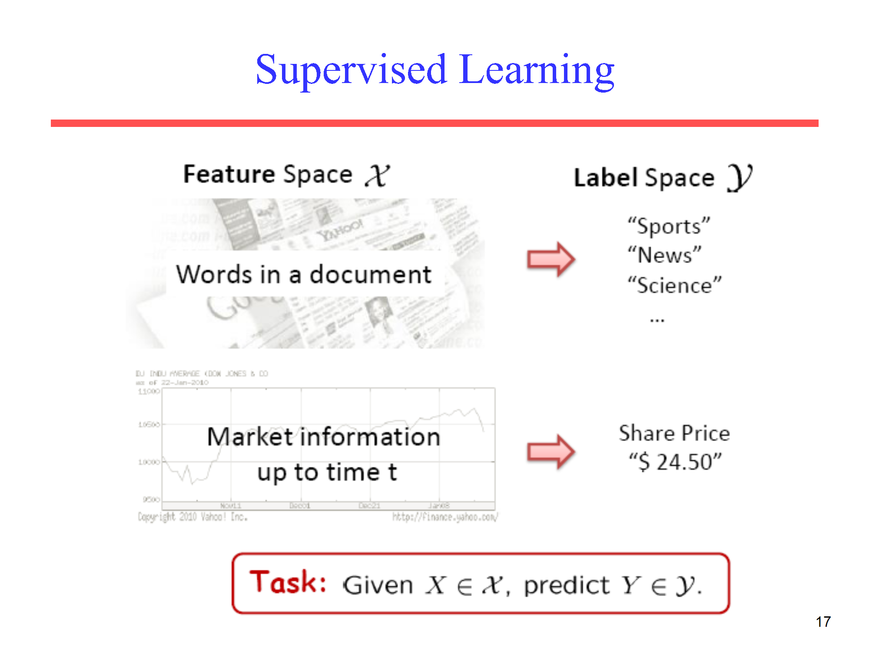

Slide 9
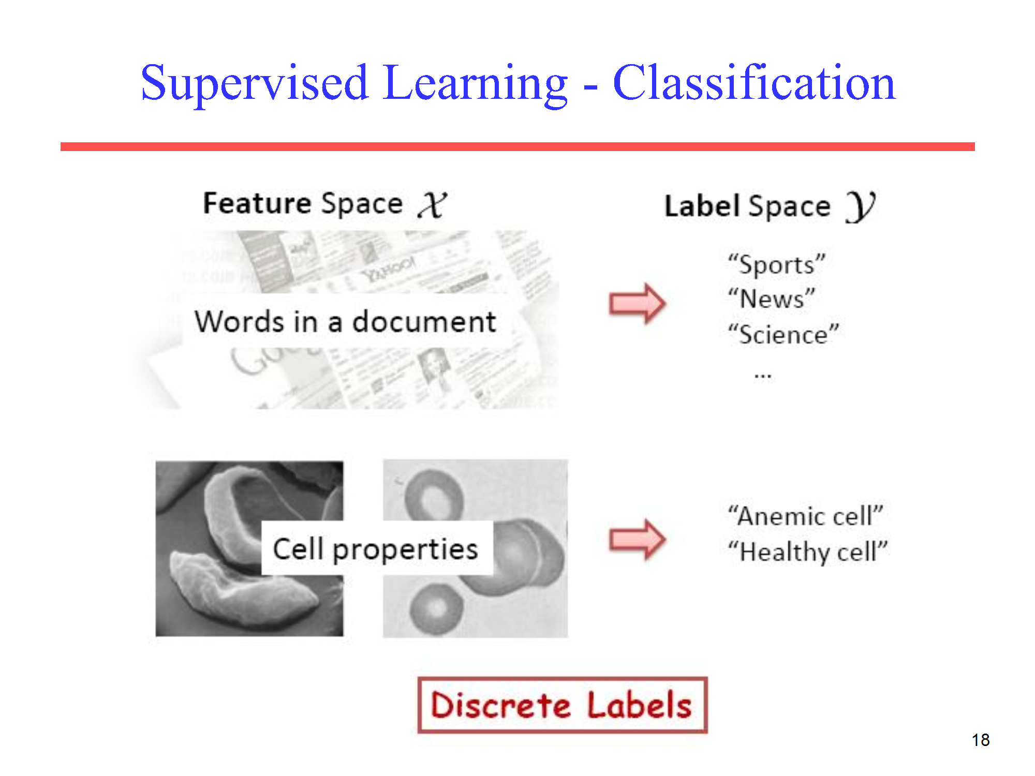

Slide 10
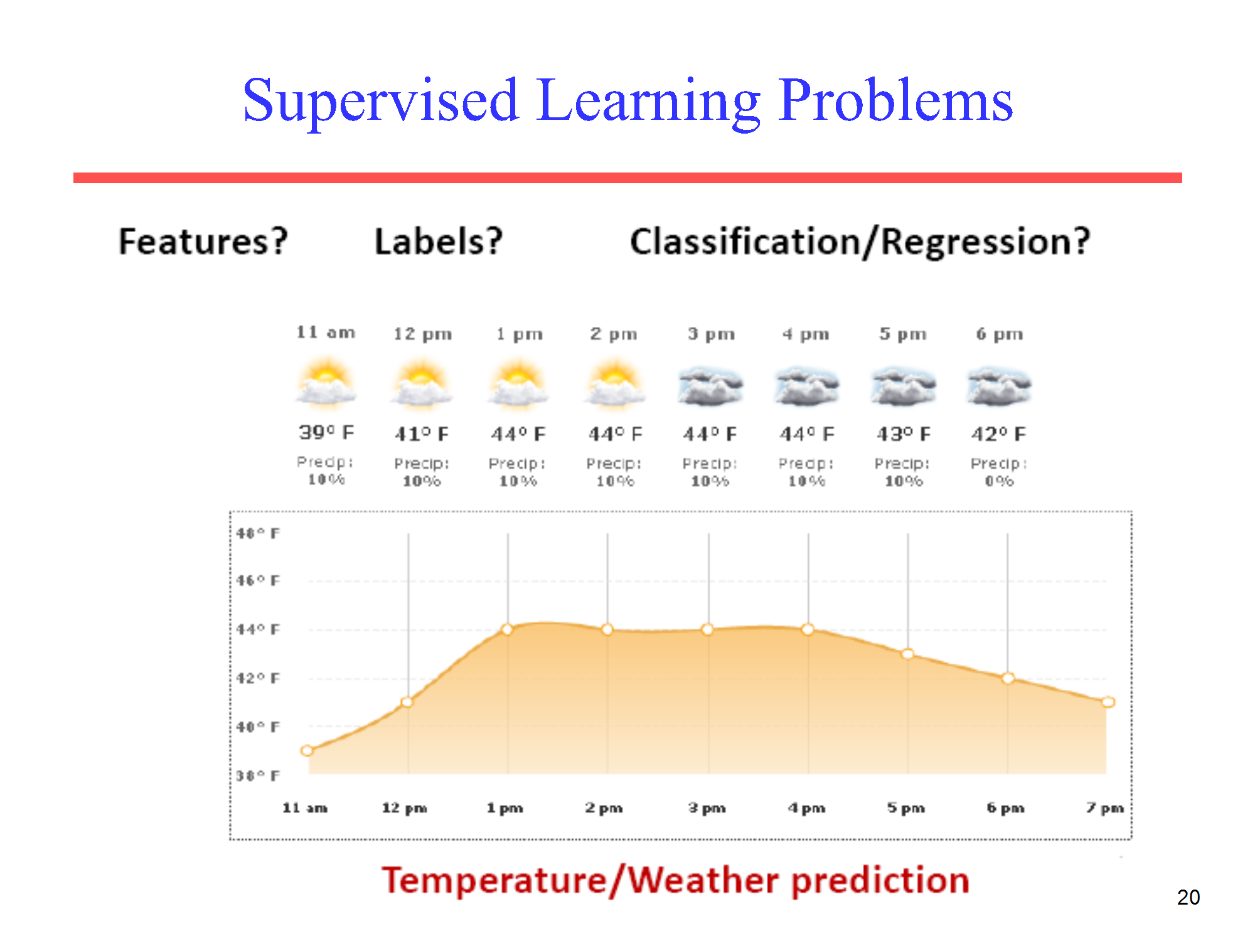

Slide 11
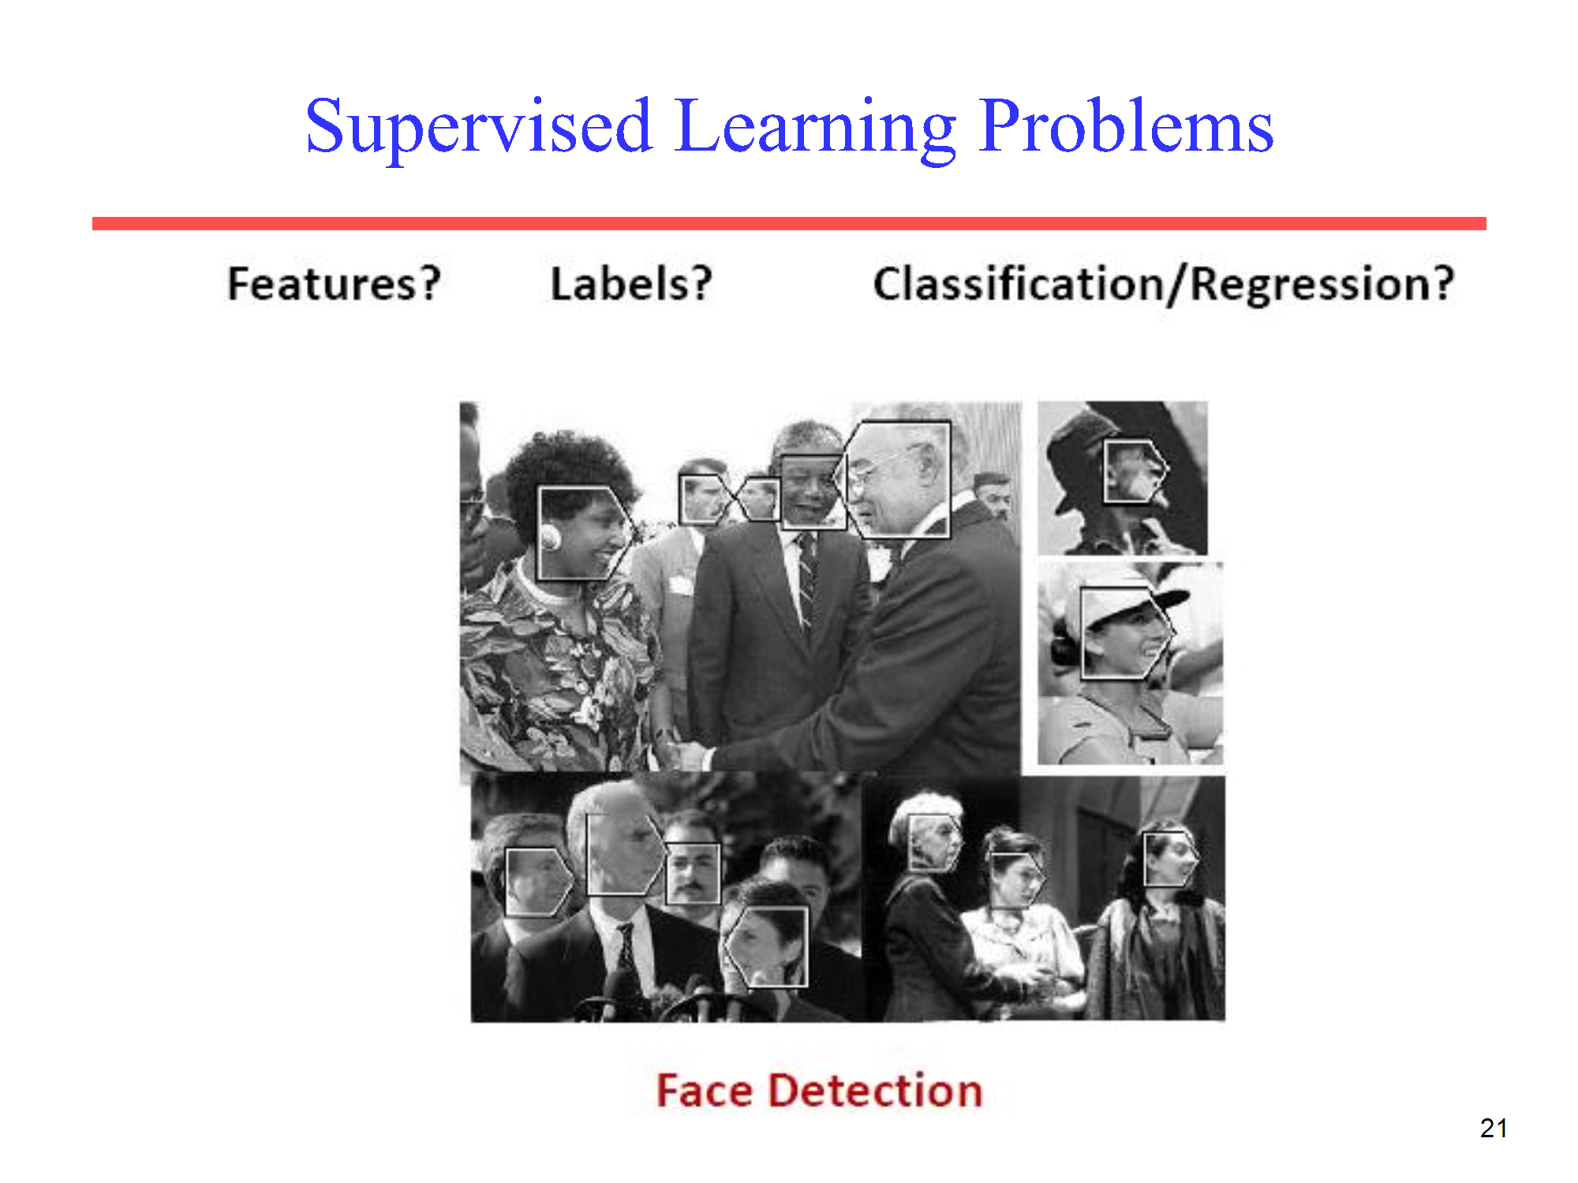

Slide 12
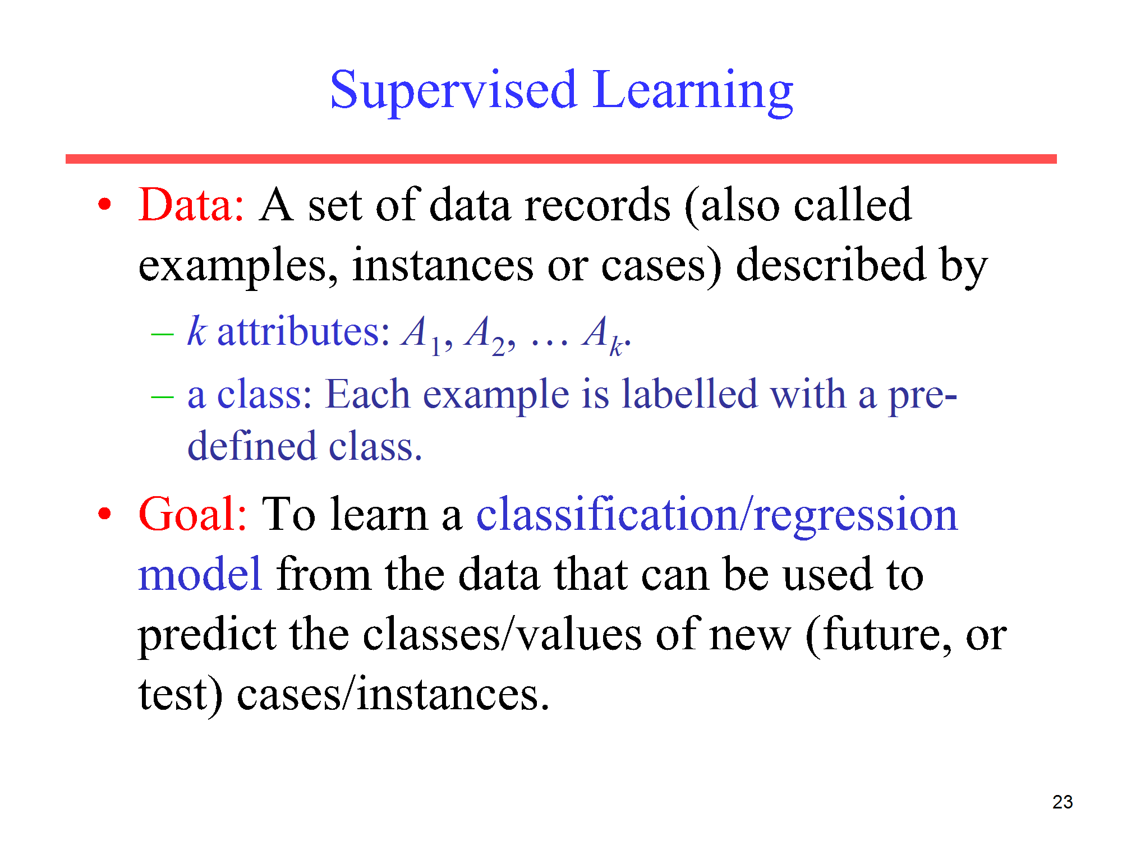

Slide 13
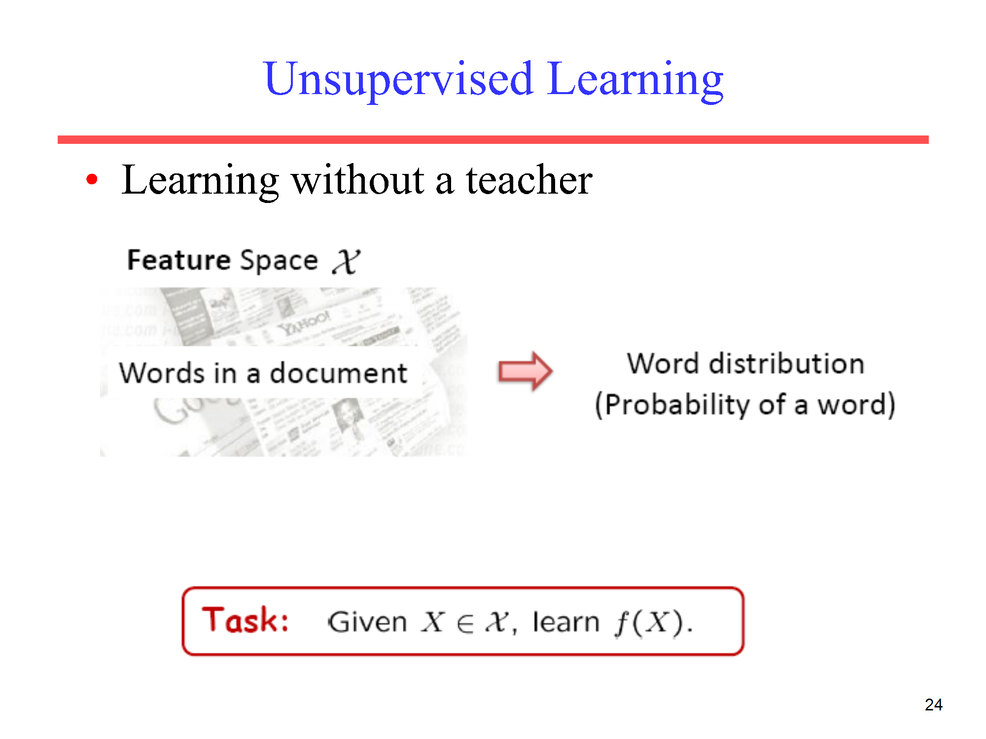

Slide 14
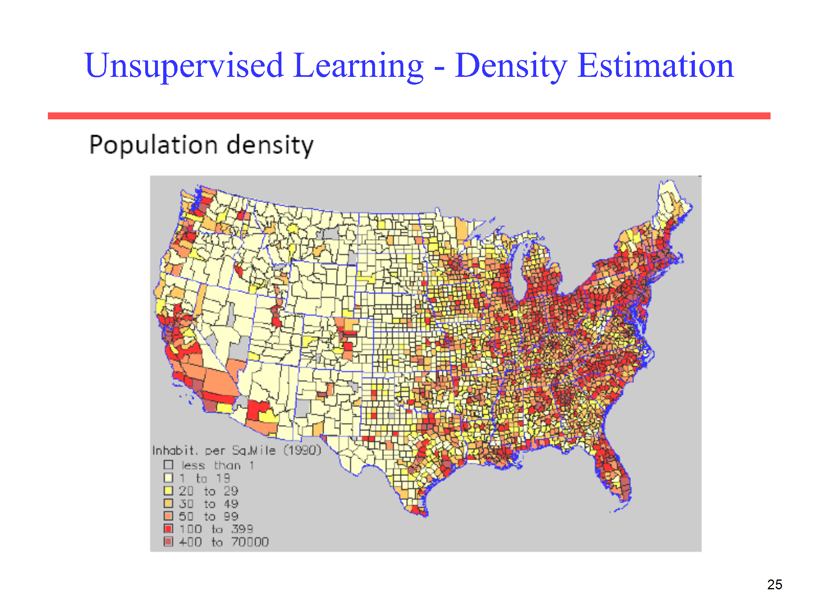

Slide 15
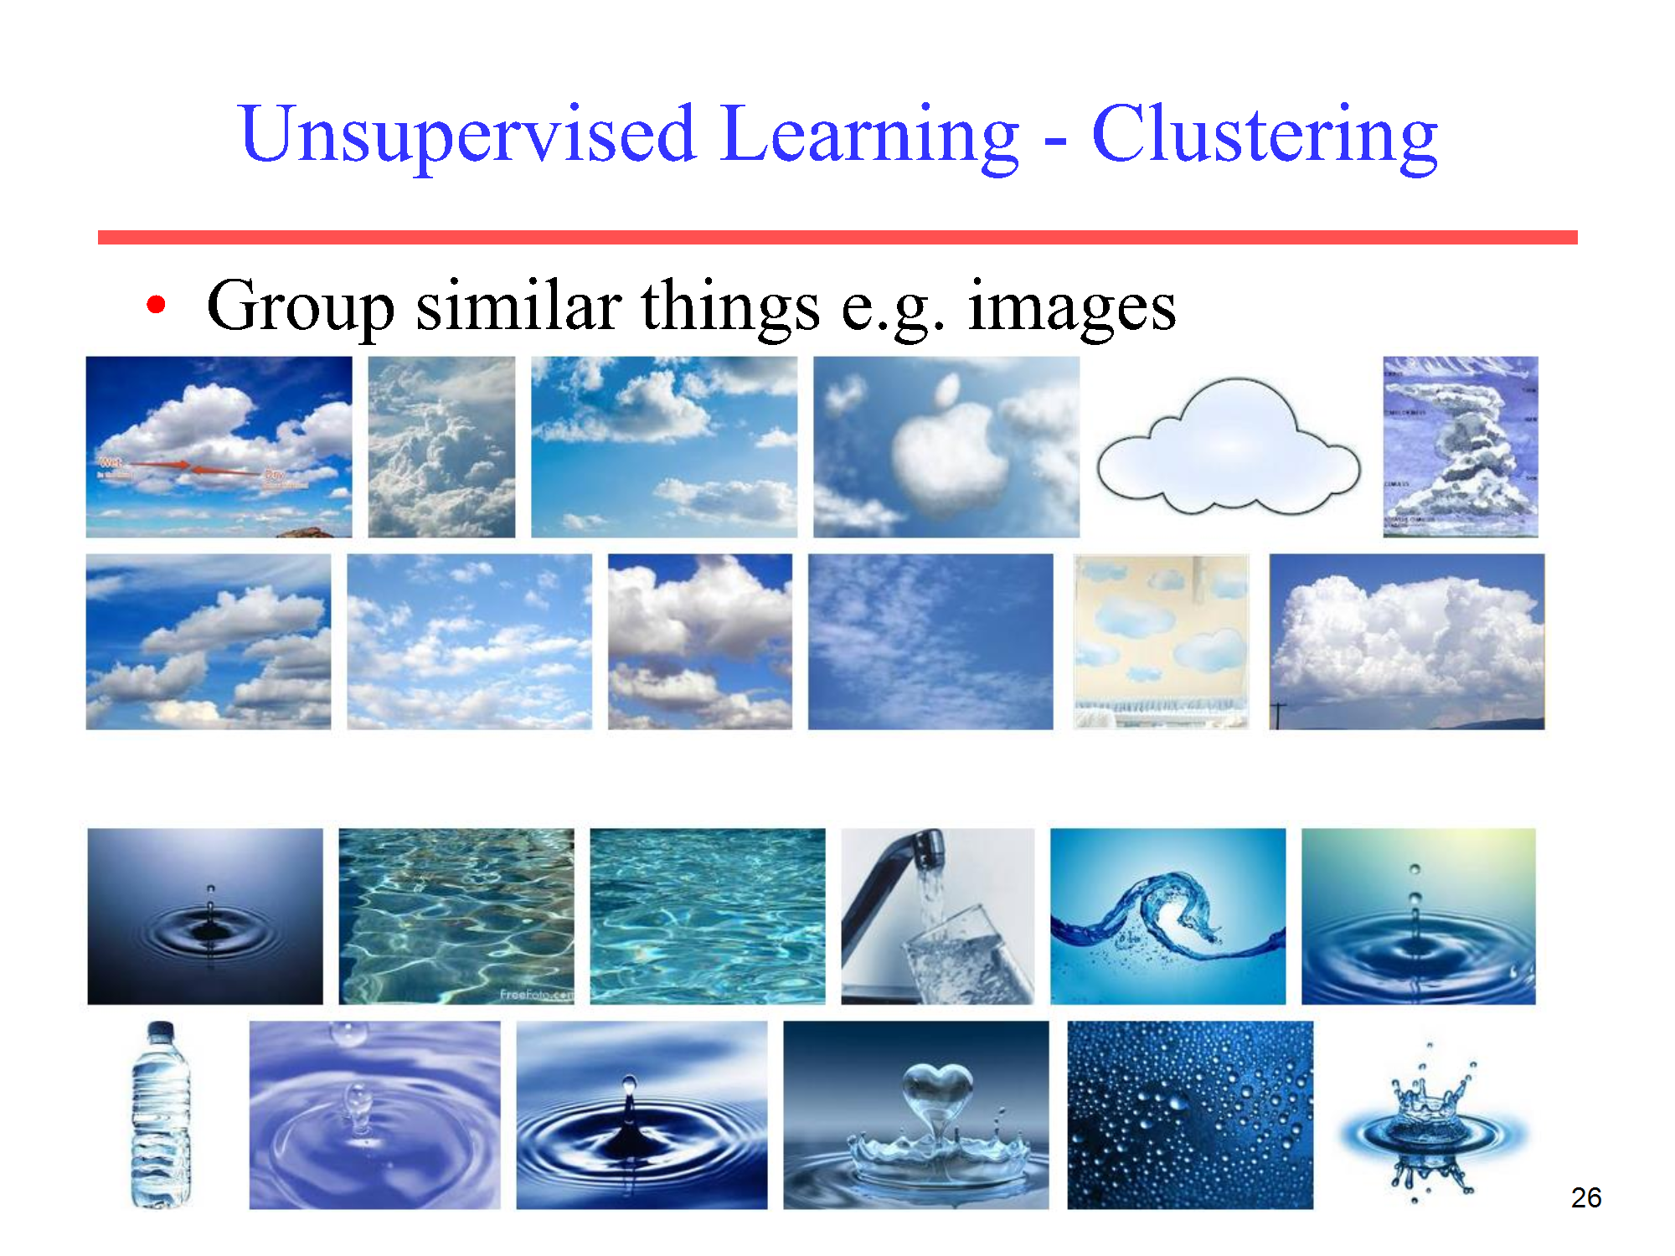

Slide 16
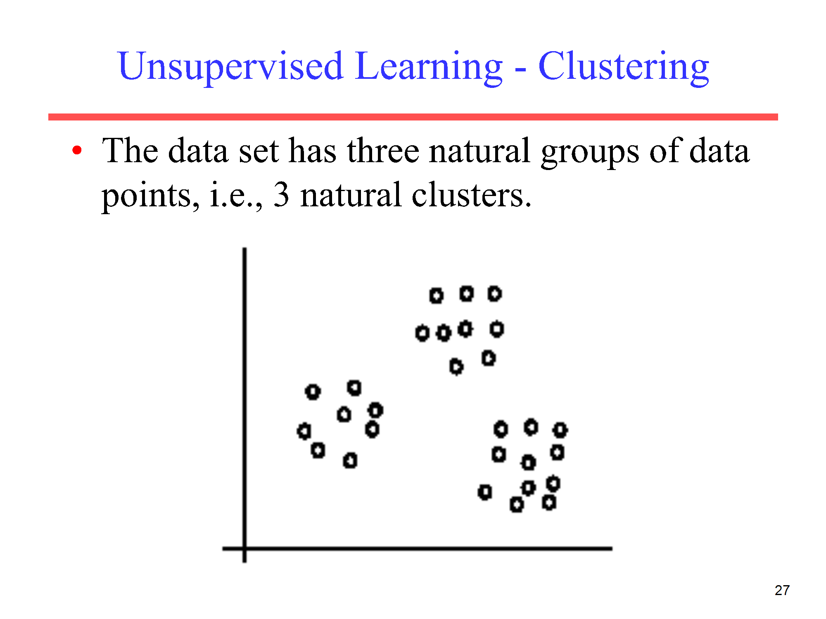

Slide 17
Reinforcement Learning
Reinforcement learning (RL) is a type of machine learning where an agent learns to make decisions by taking actions in an environment to maximize some notion of cumulative reward.
The agent receives feedback from its actions in the form of rewards or penalties and learns to adapt its strategy to improve future performance.

Slide 18
Reinforcement Learning Examples
Game Playing: In games like chess or Go, the RL agent improves its play by trying different strategies and learning which actions lead to winning more games through trial and error.
Robotics: A robot can learn to walk, pick up objects, or navigate a room through reinforcement learning. It performs actions, observes the outcome, and gradually develops a refined movement strategy by receiving feedback in the form of successful or unsuccessful task completion.
Self-driving Cars: RL can be used to help autonomous vehicles make decisions such as when to change lanes or adjust speed by continuously receiving feedback from the driving environment and honing its decision-making process to ensure safety and efficiency.

